Slide 1
Introduction to Data Engineering
– Kafka
Dávid Szabó

Slide 2
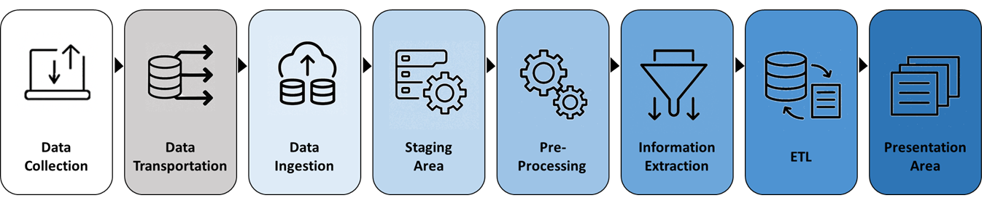
Data Pipelines – Where Data Ingestion Starts?
Data Ingestion:
  Ingestion is the first step owned by data engineers
  Collection and transportation are external dependencies
    Transportation is a gray zone — sometimes tightly coupled with ingestion
  Ingestion is the formal entry of data into the data platform
  Accepts data from transportation layer
    Performs basic validation, metadata tagging, and raw persistence
    Writes to staging area (e.g., Bronze layer)

Slide 3
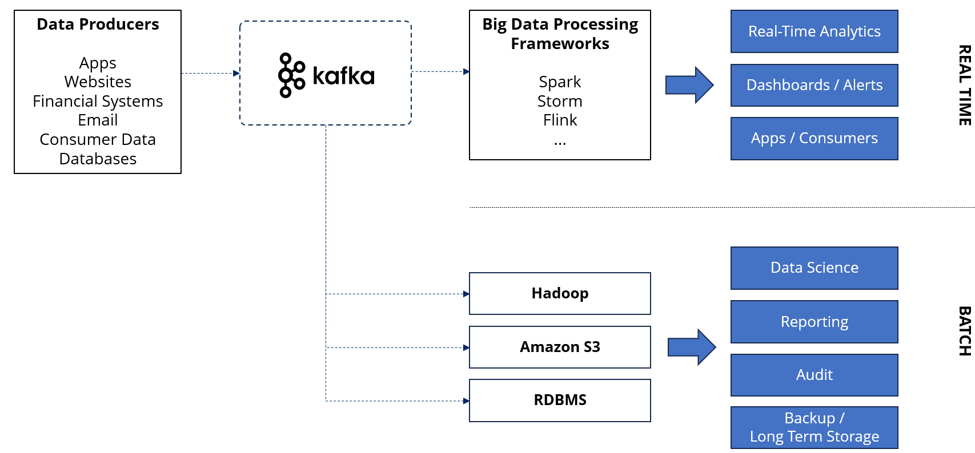
Kafka
In Big Data is a common pattern to have Kafka as an „ingestion buffer”
It’s also common to have Kafka serve both:
  a „speed layer” for real-time applications
  a „slow layer” for data ingestion into stores for later analytics

Slide 4

What is Apache Kafka?
An open-source distributed event streaming platform for
  data integration,
  mission-critical applications,
  streaming analytics and
  high-performance data pipelines

Slide 5
What is Event Streaming?
It is the practice of capturing data in
  i) real-time from event sources (e.g. databases, sensors, applications) in the form of streams of events;
  ii) storing these event streams durably for later retrieval;
  iii) manipulating, processing, and reacting to the event streams in real-time as well as retrospectively;
  iv) and routing the event streams to different destination technologies as needed.
A typical challenge is data integration:
  Protocol –
    how the data is transported?
    TCP, HTTP, REST, FTP, JDBC…
  Data format –
    how the data is parsed?
    Binary, CSV, JSON, Avro…
  Data schema & evolution –
    how the data is shaped and may change?
Source System
Source System
Source System
. . .
data
data
data
Target System
Target System
Target System
. . .

Slide 6
What is Event Streaming?
It is the practice of capturing data in
  i) real-time from event sources (e.g. databases, sensors, applications) in the form of streams of events;
  ii) storing these event streams durably for later retrieval;
  iii) manipulating, processing, and reacting to the event streams in real-time as well as retrospectively;
  iv) and routing the event streams to different destination technologies as needed.
A typical challenge is data integration:
  Protocol –
    how the data is transported?
    TCP, HTTP, REST, FTP, JDBC…
  Data format –
    how the data is parsed?
    Binary, CSV, JSON, Avro…
  Data schema & evolution –
    how the data is shaped and may change?
Website Events
Pricing Data
Sensor Data
. . .
data
data
data
Database
Analytics
Audit
. . .

Slide 7

Kafka to the Rescue
Kafka was created at LinkedIn at 2011 to service internal stream processing
Written in Java
Quickly gained popularity and became an Apache Foundation project
Nowadays mainly maintained by Confluent, IBM, Yelp, Netflix, ...
Typical use-cases:
  Messaging systems
  Activity Tracking
  Gather metrics from many different locations
  Application logs analysis
  De-coupling of system dependencies
  Integration with Big Data technologies like Spark,
  Flink, Storm, Hadoop.
  Event-sourcing store
Website Events
Pricing Data
Sensor Data
. . .
Database
Analytics
Audit
. . .

Slide 8
Kafka Core Concepts – Overview
Topics organize related events:
  E.g. logs of a specific application
  Rougly analogous to SQL tables
Producers are applications that send data into topics:
  They are deployed outside Kafka and only interact with it
  At code level they integrate with Kafka client libraries (Java, Python, Go, etc.)
Consumers are applications that pull data from topics:
  They are deployed outside Kafka and only interact with it
  At code level they integrate with Kafka client libraries (Java, Python, Go, etc.)
Producer
topic
Consumer

Slide 9
Kafka Core Concepts – Overview
Topics oragnize related events:
  E.g. logs of a specific application
  Rougly analogous to SQL tables
Producers are applications that send data into topics:
  They are deployed outside Kafka and only interact with it
  At code level they integrate with Kafka client libraries (Java, Python, Go, etc.)
Consumers are applications that pull data from topics:
  They are deployed outside Kafka and only interact with it
  At code level they integrate with Kafka client libraries (Java, Python, Go, etc.)
Client-server architecture:
  Topics are stored on servers, called Kafka brokers
  Producers and consumers are the clients
Producer
...
broker
broker
.
.
.
.
.
.
topic
topic
topic
topic
Consumer
. . .

Slide 10
Kafka Core Concepts – Topics
A topic is a particular stream of data
  Stream: sequence of messages
Similar to a table in a database
Identified by its name
Any kind of message format (JSON, Avro, binary, ...)
You can have as many as you want
Its not queryable, use producers to write them and consumers to read them
Producer
broker
traffic
logs
orders
Consumer
Notes:
Logical (message sending perspective) Architecture -> partitions and so
Physicyal: Zookeeper and so ->

Slide 11
Kafka Core Concepts – Partitions and Offsets
Topics are broken down into a number of partitions
A single topic may have multiple partitions:
  no hard limit on how many (up to 100 its quite common)
The number is specified at topic creation
Messages within each partition are ordered
  but not accross partitions
Each message within a partition gets incremental id, called offset:
  an offset only have meaning for a specific partition
  same offset for another partition does not guarantee the same message
Kafka topics are immutable: once message is written it cannot be modified
Message is assigned randomly to a partition if no message key is provided
Partition 0
0
1
2
3
4
5
.
.
.
Producer
write
Partition 1
0
1
2
3
.
.
.
topic
.
.
.
Partition N
0
1
2
3
4
5
6
.
.
.
message offset
Notes:
Logical (message sending perspective) Architecture -> partitions and so
Physicyal: Zookeeper and so ->

Slide 12
Kafka Core Concepts – Message Keys
Producer can send key with the message (number, string, ...)
Based on the key the producer decides to which partition it sends the message:
Partition 0
0
1
2
3
4
5
.
.
.
write
Partition 1
0
1
2
3
Producer
.
.
.
topic
.
.
.
Partition N
0
1
2
3
4
5
6
.
.
.
message offset
Notes:
Logical (message sending perspective) Architecture -> partitions and so
Physicyal: Zookeeper and so ->

Slide 13
Kafka Core Concepts – Message Keys
Producer can send key with the message (number, string, ...)
Based on the key the producer decides to which partition it sends the message:
  If key == null partition is selected at random
Partition 0
0
1
2
3
4
5
.
.
.
key: null
Producer
Partition 1
0
1
2
3
.
.
.
topic
.
.
.
Partition N
0
1
2
3
4
5
6
.
.
.
message offset
Notes:
Logical (message sending perspective) Architecture -> partitions and so
Physicyal: Zookeeper and so ->

Slide 14
Kafka Core Concepts – Message Keys
Producer can send key with the message (number, string, ...)
Based on the key the producer decides to which partition it sends inside the topic:
  If key == null partition is selected at random
  If key != null same partition is assigned to the same key
Partition 0
0
1
2
3
4
5
.
.
.
key (person_id): 1
Producer
Partition 1
0
1
2
3
.
.
.
topic
.
.
.
key (person_id): 6
0
1
2
3
4
5
6
Partition N
.
.
.
message offset
Notes:
Logical (message sending perspective) Architecture -> partitions and so
Physicyal: Zookeeper and so ->

Slide 15
Kafka Core Concepts – Message Keys
Producer can send key with the message (number, string, ...)
Based on the key the producer decides to which partition it sends inside the topic:
  If key == null partition is selected at random
  If key != null same partition is assigned to the same key
Use key if order is important
person_id_1
person_id_2
Partition 0
0
1
2
3
4
5
.
.
.
Producer
Partition 1
0
1
2
3
.
.
.
topic
.
.
.
person_id_6
person_id_7
0
1
2
3
4
5
6
Partition N
.
.
.
message offset
Notes:
Logical (message sending perspective) Architecture -> partitions and so
Physicyal: Zookeeper and so ->

Slide 16
Kafka Core Concepts – Message Anatomy
So Kafka only accepts bytes
Clients obviously uses higher-level objects (Integer, String, etc.) for Key and Value
  To transform these objects into binaries a Producer Serializer is needed
  To transform the binaries into objects a Consumer Deserializer is needed
Key-binary
(can be null)
Value-binary
(can be null)
Compression Type
(none, gzip, snappy, lz4, zstd)
Producer
write
Headers (optional)
Key
Value
Key
Value
Partition + Offset
Timestamp (system or user set)

Slide 17
Kafka Core Concepts – Serialization / Deserialization
The serialization/deserialization is an important implementation choice
Changing the serialization type for the topic breaks the client at code level (better to create a new topic)
Producer
Consumer
Key-object
123
Value-object
„hello world”
Key-object
123
Value-object
„hello world”
int
string
int
string
Key Serializer=
Integer Serializer
Value Serializer=
String Serializer
Key Deserializer=
Integer Deserializer
Value Deserializer=
String Deserializer
bytes
bytes
bytes
bytes
Key-binary
01110011
Value-binary
101011101110000001010110
Key-binary
01110011
Value-binary
101011101110000001010110
Notes:
Logical (message sending perspective) Architecture -> partitions and so
Physicyal: Zookeeper and so ->

Slide 18
Kafka Core Concepts – Consumers
Consumer reads data from a topic in a pull model
A consumer can read multiple partitions
  Each partition is being read in order, from lower to higher offset values
Typically a broker does not contain all partitions, but a consumer know which broker to read from
  In case of broker failure, a consumer know how to recover
0
1
2
3
4
5
.
.
.
Consumer 1
Partition 0
Partition 1
0
1
2
3
.
.
.
Topic
.
.
.
Partition N
0
1
2
3
4
5
6
.
.
.
Consumer 2
message offset
Notes:
Logical (message sending perspective) Architecture -> partitions and so
Physicyal: Zookeeper and so ->

Slide 19
Kafka Core Concepts – Consumer Groups
A set of consumers from the same application
A consumer always belong to a group, even if it is a lonely consumer
Each consumer in the same group reads exlusive partitions
Partition 0
Consumer 1
Partition 1
Consumer 2
Topic
Partition 2
Consumer 3
Partition 3
app-1-consumer-group
Partition 4
Notes:
a set of consumers from the same application that work together to consume and process messages from one or more topics.

Slide 20
Kafka Core Concepts – Consumer Groups
If there are more consumers than partitions:
Partition 0
Consumer 1
Topic
Partition 1
Consumer 2
Partition 2
Consumer 3
inactive
Consumer 4
app-1-consumer-group
Notes:
a set of consumers from the same application that work together to consume and process messages from one or more topics.

Slide 21
Kafka Core Concepts – Consumer Groups
If there are more consumer groups on one topic:
Partition 0
Consumer 1
Topic
Partition 1
Consumer 2
Partition 2
app-1-consumer-group
Consumer 1
app-2-consumer-group
Notes:
a set of consumers from the same application that work together to consume and process messages from one or more topics.

Slide 22
Kafka Core Concepts – Consumer Groups
If there are more consumer groups on one topic:
Partition 0
Consumer 1
Topic
Partition 1
Consumer 2
Partition 2
app-1-consumer-group
Consumer 1
Topic 2
Partition 0
app-2-consumer-group
Notes:
a set of consumers from the same application that work together to consume and process messages from one or more topics.

Slide 23
Kafka Core Concepts – Consumer Offset
After a consumer reads a message it sends commit to Kafka regarding the offset
Kafka keep track of this information in the __consumer_offsets topic
If a consumer fails and recover it can continue from where it was
There are multiple strategies from consumers side when to send the commit
0
1
2
3
4
5
.
.
.
Consumer 1
Partition 0
Topic
Partition 1
0
1
2
3
4
5
6
.
.
.
message offset

Slide 24
Kafka Core Concepts – Brokers and Topics
A Kafka cluster contains multiple brokers („bootstrap servers”)
Each brokers stores only certain topic partitions:
  It’s common that a broker contains no partition at all from a topic
  A partition is stored on one broker (if there is no replication configured)
By connecting to a broker a client is automatically connected to the whole cluster
  In case the needed partition is not on the accessed broker, clients can get where to connect
  After connecting the broker sends back the list of brokers and the stored partitions
Client
1.
Connect to bootstrap server
2.
List of brokers and topics
3.
Connect to proper broker
Broker 1
Broker 2
Broker 3
Topic A
Partition 0
Partition 2
Partition 1
Topic B
Partition 1
Partition 0

Slide 25
Kafka Core Concepts – Topic Replication
We can configure replicaton number for a topic (ideally should be 2-3)
Each partition is replicated to another broker (or brokers)
For every partition there is one leader and multiple ISR (in-sync replica)
Producer can send data only to the partition leader broker
Consumer by default can pull data only from the partition leader:
  This can be configured to be able to use the closest ISR for cost and latency optimization
When a leader broker fails another takes its place
So for a replication factor of N the topic can be recovered until N-1 broker failures
Broker 1
Broker 2
Broker 3
Partition 0
replication
Partition 1
replication
Partition 1
Leader
ISR
replication
Partition 0
Partition 0

Slide 26
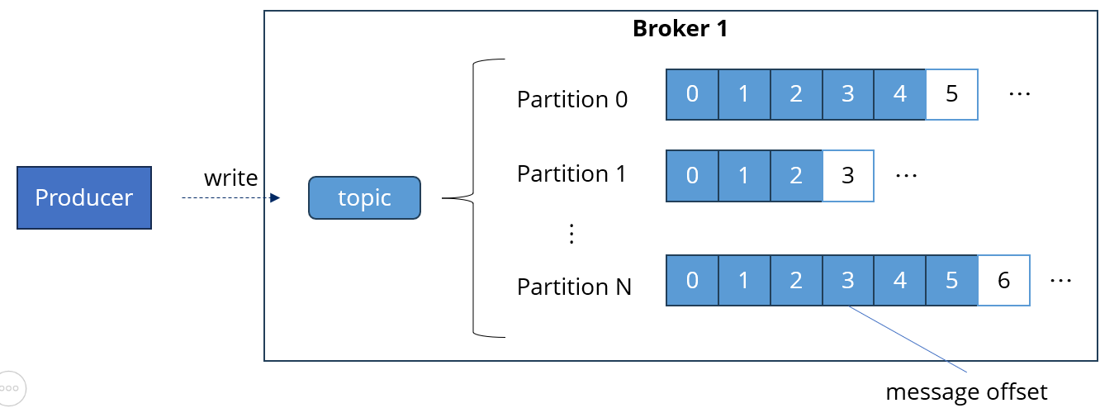
Kafka Core Concepts – Producer Acknowledgement Options
acks=0 :
  No Acknowledgement: Producer does not wait for any acknowledgment from the broker.
  Use Case: High throughput, low latency, but risk of data loss.
acks=1
  Leader Acknowledgement: Producer waits for the leader to write the record to its local log.
  Use Case: Balanced approach, moderate latency, and throughput.
acks=all
  All Replicas Acknowledgement: Producer waits for all in-sync replicas to acknowledge the record.
  Use Case: Highest reliability, ensures no data loss, but higher latency.

Slide 27
Kafka CLI tool
A suite of command-line tools for managing and interacting with Kafka
It is bundled with Kafka binaries
Key Features:
  Start and stop Kafka
  Manage topics (create, list, and delete)
  Manage partitions and replicas
  Monitor and Debug Kafka clusters

Slide 28
Kafka CLI tool – Kafka Topics
Demo
The kafka-topics.sh tool is used to manage topics in Kafka.
Create, list, describe, and delete topics
Alter topic configurations
Add partitions to existing topics
Example:
  kafka-topics.sh --create
  --topic my-topic
  --bootstrap-server localhost:9092
  --partitions 3
  --replication-factor 1

Slide 29
Kafka CLI tool – Kafka Console Producer
Demo
The kafka-console-producer.sh tool is used to send messages to a Kafka topic from the command line.
Produce messages to a specified topic.
  With key
  Without key
Read input from standard input (stdin).
Example:
  kafka-console-producer.sh --topic my-topic
  --bootstrap-server localhost:9092

Slide 30
Kafka CLI tool – Kafka Console Consumer
Demo
The kafka-console-consumer.sh tool is used to read messages from a Kafka topic from the command line
Consume messages from a specified topic:
  From tail of the topic
  From the beginning of the topic
Can display key and value as well
Example:
  kafka-console-consumer.sh --topic my-topic
  --bootstrap-server localhost:9092
  --from-beginning

Slide 31
Kafka CLI tool – Kafka Consumer Groups
Demo
The kafka-consumer-groups.sh tool is used to manage consumer groups
Describe consumer groups
List consumer groups
Delete consumer groups
Example:
  kafka-consumer-groups.sh --bootstrap-server localhost:9092
  --describe
  --group my-group

Slide 32
Kafka CLI tool – Kafka Server Start
The kafka-server-start.sh tool is used to start a Kafka broker.
Start a Kafka broker using a specified properties file.
Example:
  kafka-server-start.sh config/server.properties

Slide 33
Kafka CLI tool – Kafka Server Stop
The kafka-server-stop.sh tool is used to stop a running Kafka broker.
Stop a Kafka broker.
Example:
  kafka-server-stop.sh

Slide 34
Kafka Producer Implementation
Demo
Basic Java producer sending a set of messages to Kafka:
  Sending generated message set to one topic
  Using callback after sending message to be able to handle other tasks
  Implementing confirmation of the sent message by logging the message metadata

Slide 35
Kafka Consumer Implementation
Demo
Basic Java consumer reading a set of messags from Kafka:
  Set string deserializers
  Set group id
  Set read from the earliest
  Implementing proper shutdown
Notes:
- Minimal consumer
- set string deserializers
- set group id
- set read from the earliest

Slide 36




Kafka Extended Ecosystem
Kafka Consumers and Producers have existed for a long time and are considered low-level
Kafka & ecosystem has introduced over time some new APIs that are higher level for specific problem sets:
  Kafka Connect: integration toolkit for streaming data between Kafka brokers and other systems using connector plugins
  Kafka Streams: solves transformations in Kafka (used as a Java lib) with exactly once capabilities
  Schema Registry: helps using Schema in Kafka
Kafka Schema Registry
Kafka Streams
Kafka Producer
Kafka Consumer
Source DB
Target DB
Kafka Connect Source
Kafka Connect Sink

Slide 37








Kafka Extended E & I – Kafka Connect
Motivation:
  The data is usually imported from the same places, e.g.
  Databases, SAP HANA, FTP, IOT, Salesforce, Twitter, Blockchain, ...
  The data is usually exported to the same places, e.g.
  S3, ElasticSearch, HDFS, JDBC, SAP HANA, Cassandra, Redis, Twitter, ...
Source connectors („Producers”) to get data from common data sources
Sink connectors („Consumers”) to put data in common data sources
Quickly re-use code that is made by experienced developers
Connectors achieve fault tolerance, idempontence, distribution, ordering
If you find available connector you should use it, oterwise you can create one or use low-level Producer/Consumer
Connect Cluster
Kafka Cluster
Soures
1
Connector
2
Broker
Sinks
Connector
3
Broker
4
Connector
Broker

Slide 38
Kafka Extended E & I – Kafka Connect Terminology
A Kafka connect cluster consists of one or more Workers (servers)
  Standalone mode = one worker
  Distributed mode = multiple workers
Kafka Connect clusters can have multiple loaded Connectors
  Each connector is a reusable piece of code (Java .jar files) on the workers’ filesystem
  There are many (open-source) connectors:
    https://docs.confluent.io/cloud/current/connectors/index.html
    https://www.confluent.io/hub/
  Write your own connector: https://docs.confluent.io/platform/current/connect/devguide.html
Connector + user configuration => Tasks
  A task is linked to a connector configuration
  A job configuration may spawn multiple tasks
Connect Cluster
Kafka Cluster
Worker 1
Worker 2
Worker 3
Broker
Broker
Broker

Slide 39
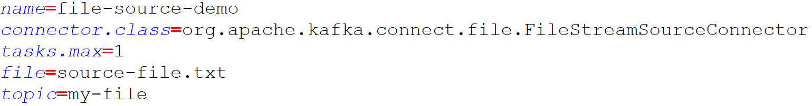
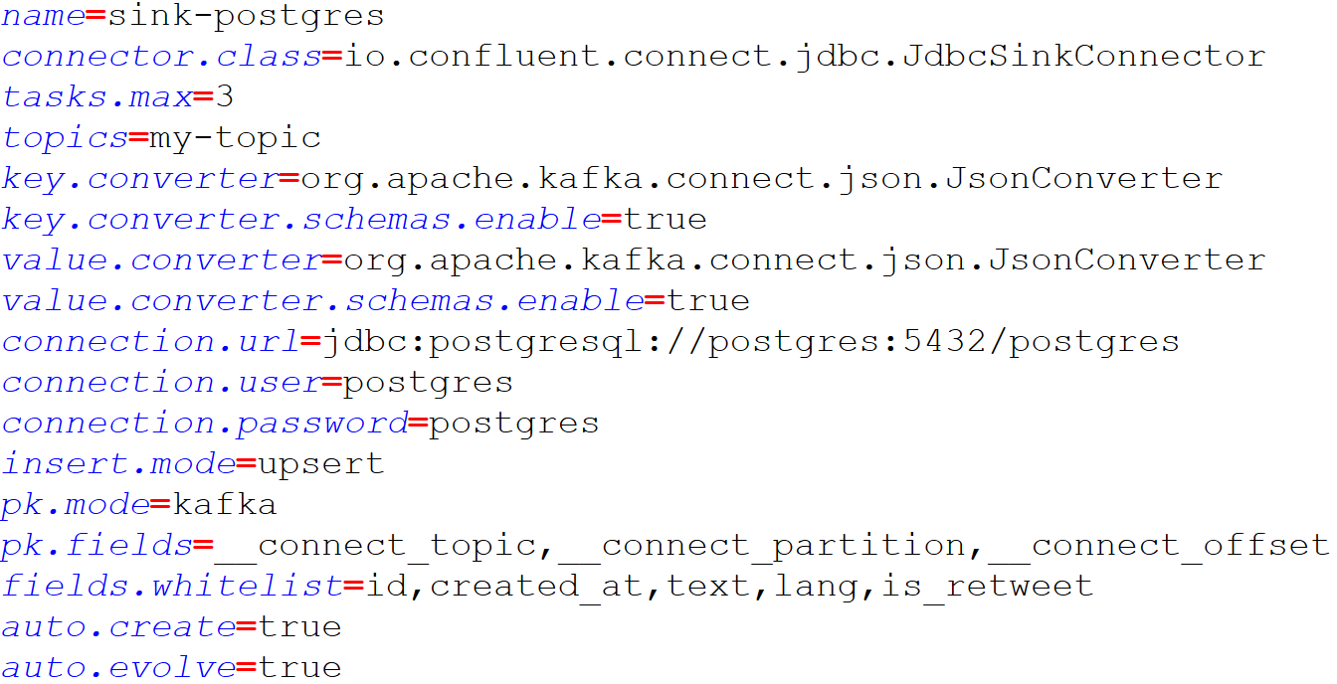
Kafka Extended E & I – Kafka Connect Terminology
Connector config 1
Connector config 2
Connect Cluster
Kafka Cluster
Worker 1
Worker 2
Worker 3
Broker
Task 1
Task 1
Task 3
Broker
Task 2
Broker

Slide 40
Kafka Extended E & I – Kafka Connect Terminology
Connector config 1
Connector config 2
X
Connect Cluster
Kafka Cluster
Worker 1
Worker 2
Worker 3
Broker
Task 1
Task 1
Task 3
Broker
Task 2
Task 3
Broker

Slide 41

Kafka Extended E & I – Kafka Streams
Motivation:
  You want to transform incoming data to increase business value, e.g.
    from the watch.later.change topic:
    stats.genre: count the number of times a specific genre was added
    stats.completed: count the number of completed episodes
    stats.watch.hours: number of hours watched per day as a time series
  With Producers and Consumers this could be achieved but would be low level and not developer friendly
Video Client Service
watch.later.change
stats.genre
Recommendation Service
Recommendation Engine in Real Time
(Kafka Streams)
stats.completed
stats.watch.hours

Slide 42
Kafka Extended E & I – Kafka Streams
Kafka Streams is a data processing and transformation library within Kafka for:
  Data transformation
  Data enrichment
  Fraud detection
  Monitoring and alerting
Features:
  Standard Java Application
  No need to create a separate cluster
  Highly scalable, elastic and fault tolerant
  Exactly-once capabilities
  One record at a time processing (no batching)
  Works for any application size

Slide 43
Kafka Extended E & I – Kafka Schema Registry
Motivation:
  Kafka does not do data verification, just takes bytes and sends them
  The client communication breaks in cases like:
    Producer sends bad data
    A field gets renamed
    Format changes from one day to another
  We need data to be self describable
  We need to be able to evolve date without breaking downstream consumers
  Why does not Kafka Brokers take care about verification?
    It would break the efficiency of Kafka

Slide 44
Kafka Extended E & I – Kafka Schema Registry
Features:
  It’s a separate component to keep the process lightweight
  Stores schema for topics in Avro (or in Protobuf or in JSON Schema)
  Producers and Consumers can talk to it
  It’s able to enforce backward, forward and full compatibility on topics
Need to pay attention to:
  Set it up well
  Make sure it’s Highly Available
  Need to slightly change the Producer and Consumer code
  Apache Avro / Protobuf / JSON Schema format has a learning curve
Kafka Schema Registry
1. Send schema
5. Retrieve schema
2. Validate
Kafka Producer
3. Avro data
4. Avro data
Kafka Consumer
6. Write data

